Slide 1

EdEasy
Educating the world
Team Id: APPYFUZZ
HackHarvard Hackathon

Slide 2
: The Problem :
Low Teacher Student Ratio
Low Attendance of Students
Disinterest in Studies
Absence of proper libraries
Disparity between education
Poor time management
Lack of Access To technology
Absence of formal training

Slide 3


Proposed Solution
Create an approach to grab the student’s attention right from the start: simple, useful and smart.
Simple Simple UI, Proper Tutorials, Quick and easy access
Useful E - Library, Video Lectures, Teacher Student Interaction, Quick Discussion Platform
Smart AI Chatbot, Automated Course recommender system, Language Learner System

Slide 4
Our Plan So Far
A Website to enable both teacher and student for enhanced approach to education
An App aimed at quick and easy education to always be in touch with what’s important
A Machine Learning Model to make life of students easier for choosing the proper course

Slide 5

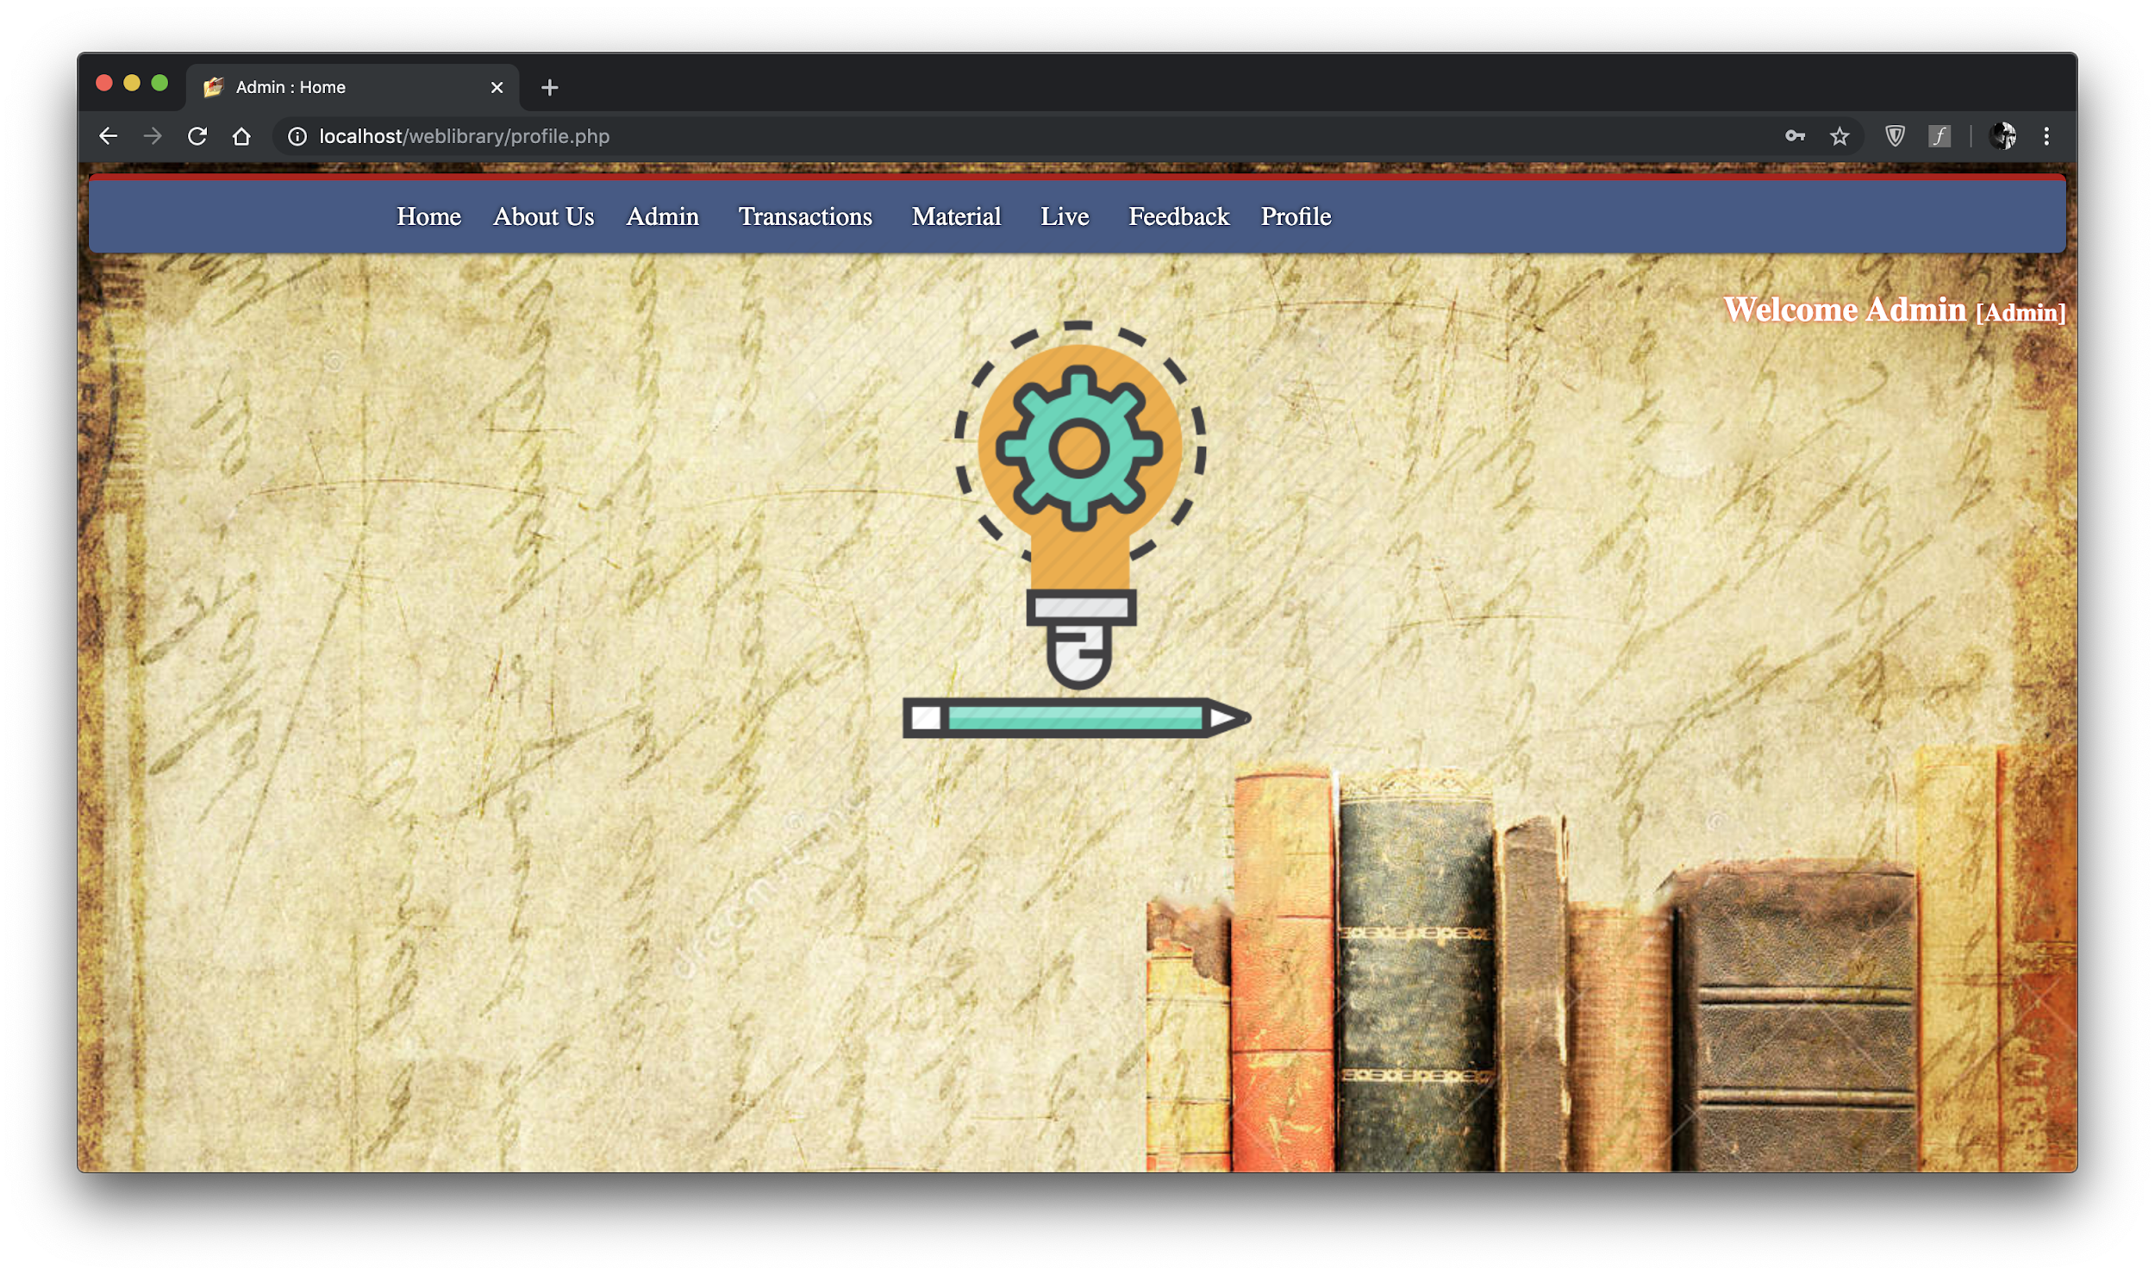
The Website
Simple and easy to understand
Simple features, hassle free to utilise
Future plans of integration with the application
Benefits which the students get

Slide 6
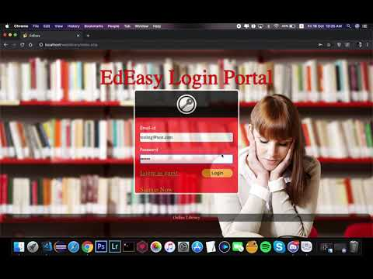

Slide 7
Allows students to register to the website or access as a guest.
Registered students get access to the full features of the website, whereas the guests have limited access.
Registered students will be able to access notes and other relevant materials which the teachers will upload on the website.
Students will be able to borrow books (like a library), and return them within a specified time period.
A ready working drawing peer-to-peer drawing board for the teachers and students. (Will be made live in future versions.)

Slide 8
A special admin panel for the developers. Will be modified for teachers.

Slide 9
: The Library Feature :
Borrowing and returning the books
Borrowed Books viewable on the application only

Slide 10
: Future Version :
The Drawing Board
A peer-to-peer drawing board, which will be like a classroom whiteboard.

Slide 11
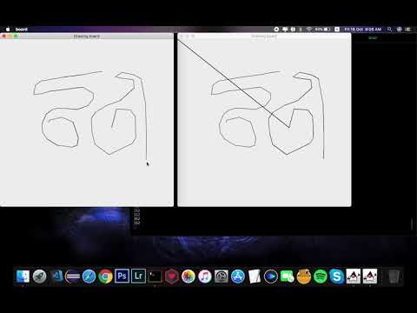

Slide 12

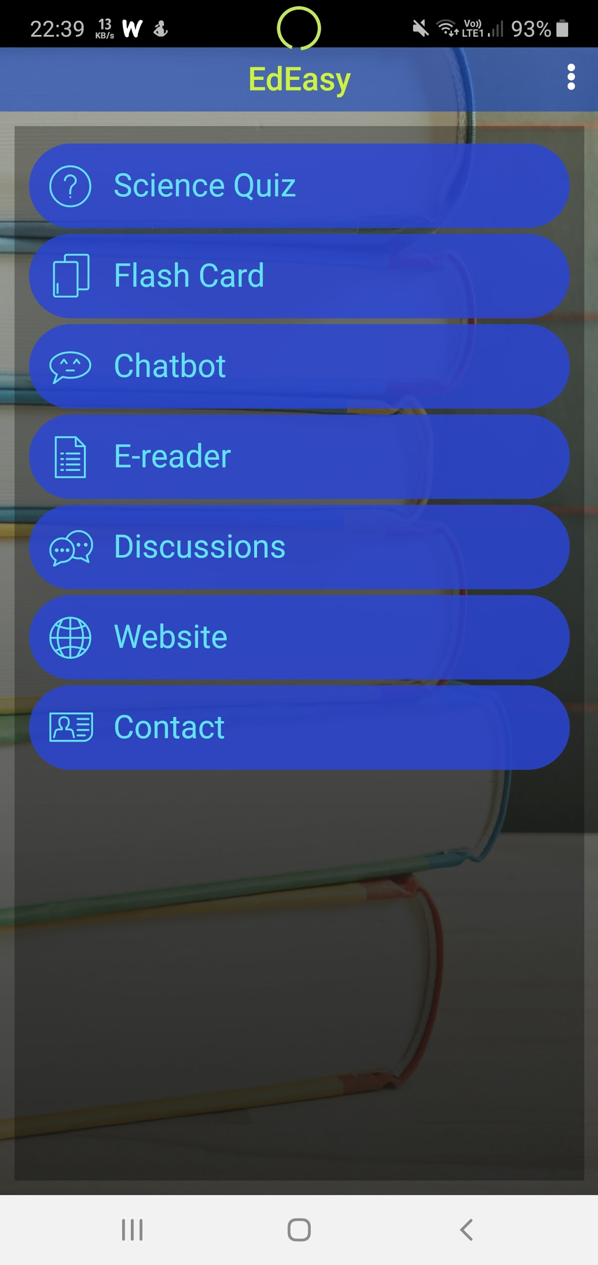
The App
How it improves the current situation
What benefits do students get
Further integration with website
Improving chatbot for better interaction
Maintaining a proper discussions forum for enhanced doubt clarification
Expansion using other app services

Slide 13
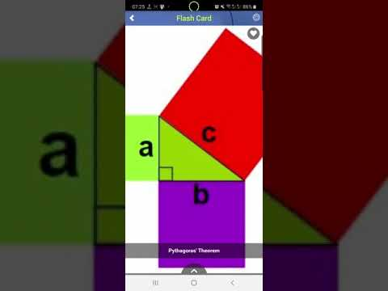

Slide 14
For sake of simplicity and easy management of resources the app has been integrated with features like chatbot, database systems..etc through the appypie platform
A simple Chatbot is maintained through Dialogflow api event handler using appypie
Our main goal is to provide easier and quicker access to education to every student
The E-Reader on the App can be used offline too
The App also provides preliminary quizzes to the students based on their standard

Slide 15
: Future Version :
Multilingual Help
A partnership with other software companies for teaching languages through our platform(Ex: Google Bolo)

Slide 16
So, what do we do with all the data collected from students all around the globe?

Slide 17
Feed it to a
Machine Learning Model!
(With a little help from your device)

Slide 18
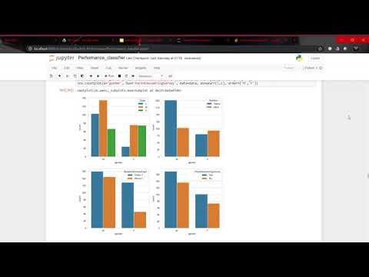

Slide 19


WHAT IS THE PURPOSE OF
ML MODEL HERE ?
(More the students better will be the performance)

Slide 20
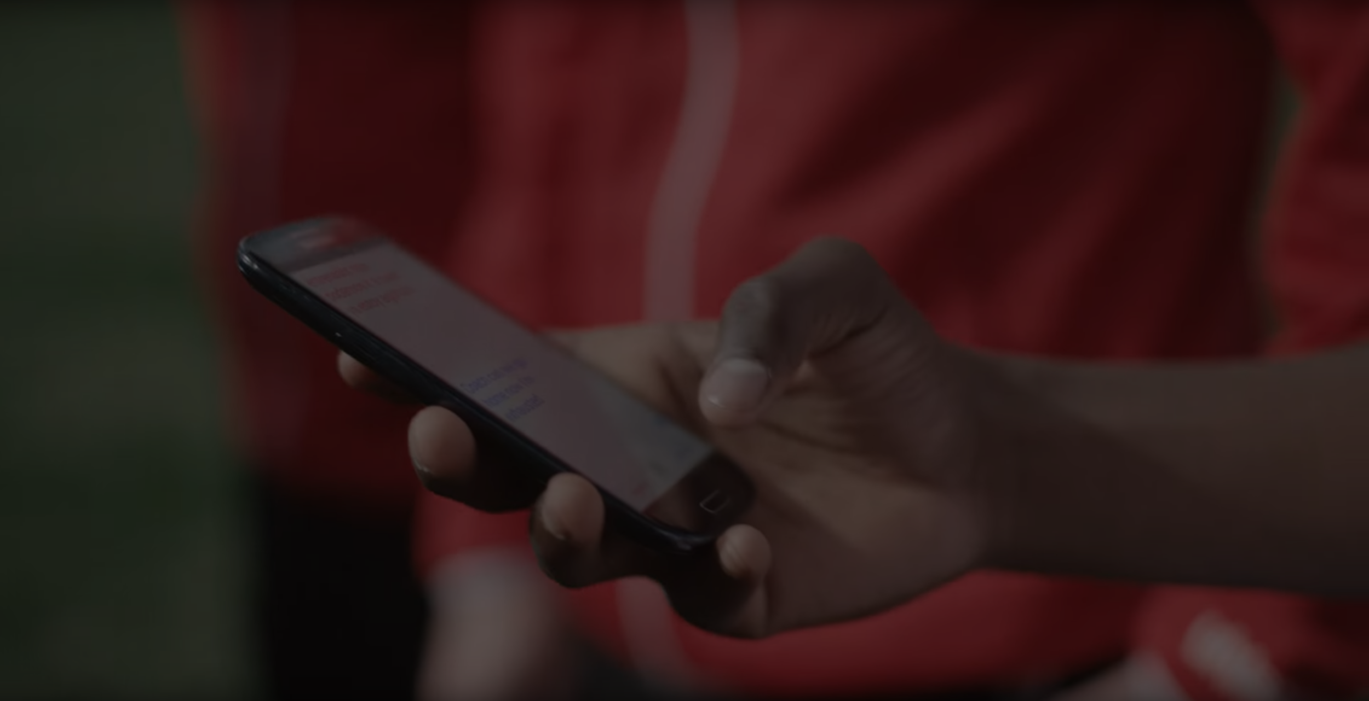
We Aim to achieve an interconnected society of teacher and students irrespective of any economic background.

Slide 21
Moving On Next...
We will start with our focus on only underprivileged students
Once our platform gains traction in the society; services will be made available to everyone but at a premium
Students from poor economic backgrounds will have an opportunity of availing all our services for free via proper documents issued by the government
We look forward to collaborating with other platforms such as Google to enhance the entire experience for students altogether
Such an initiative is sure to increase employment rates for teachers as well as increase learning interest for students
A proper web and android app integration supported by AI and ML to empower the future in a very simplistic way is what we aim at achieving

Slide 22
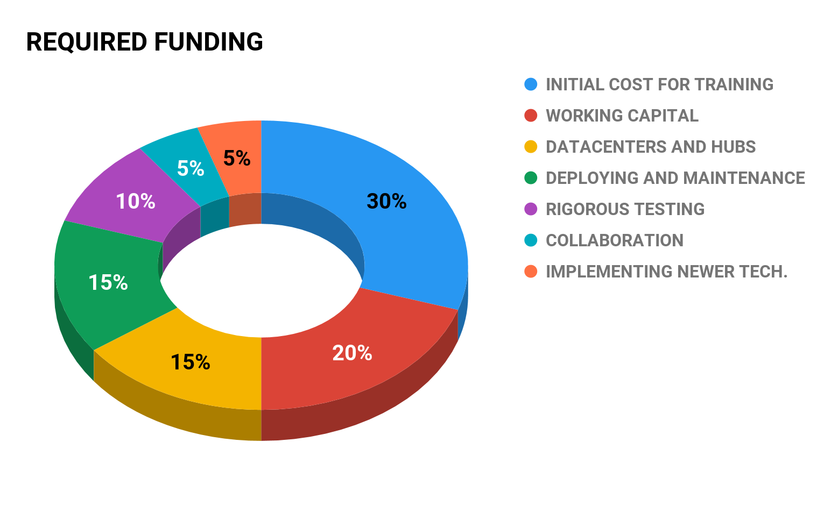

Slide 23
Planned Timeline
December 2019
June 2020
February 2020
November 2020
Integrate Website with Android app
Gather resources and funding for maintenance
Increase Awareness
Make publicly available
Provide formal training
2019 |  |  |  | 2020
Gather all data and use the proposed ML model to enhance user experience
Enhance further by integrating apps like Google Bolo, Google Translate into our platform

Slide 24

The 3 Perspectives
The Students
The Teachers
The Schools
Better interaction
Increased Interest
Quick Revision
Free Library
Appropriate Courses
Better Teaching Method
Virtual Classes
Formally Trained
Educate Online
Create Discussions
Increased Overall Attendance
Compete Irrespectively
Higher Student Acceptance Rate
Better Interconnected Society

Slide 25

Our Team
Anindit Sinha
(Web Developer)
Shreyasis Roy
(App & ML Model Designer)
Ankita Thakur
(Data Aggregation)

Slide 26
Thank You

Slide 27
Any Queries... ??

